Slide 1
Object Oriented Programming(Java) Lecture 14

Slide 2
Content
Java Thread
The Java Thread Model
Multithreading in Java
Main Java Thread
How to Create a Java Thread?

Slide 3
Java Thread :
Imagine a stockbroker application with lots of complex capabilities. These are few of its functions:
To download the last stock option prices
To check prices for warnings
Analyze historical data for company XYZ

Slide 4
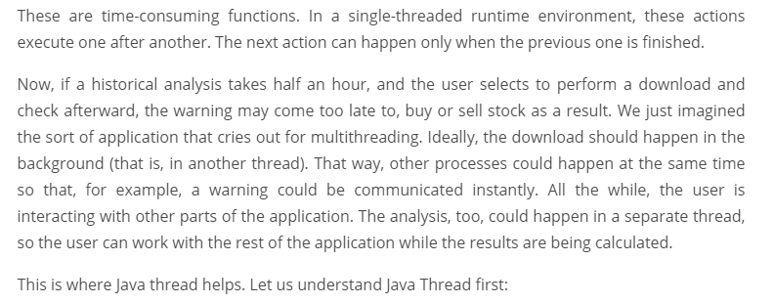
Java Thread :

Slide 5
Java Thread :
A thread is actually a lightweight process. Unlike many other computer languages, Java provides built-in support for multithreaded programming. A multithreaded program contains two or more parts that can run concurrently. Each part of such a program is called thread and each thread defines a separate path of execution.

Slide 6
The Java Thread Model :
The Java run-time system depends on threads for many things. Threads reduce inefficiency by preventing the waste of CPU cycles.
Threads exist in several states. Following are those states:
New – When we create an instance of Thread class, a thread is in a new state.
Runnable – The Java thread is in running state.
Suspended – A running thread can be suspended, which temporarily suspends its activity. A suspended thread can then be resumed, allowing it to pick up where it left off.
Blocked – A java thread can be blocked when waiting for a resource.
Terminated – A thread can be terminated, which halts its execution immediately at any given time. Once a thread is terminated, it cannot be resumed.

Slide 7
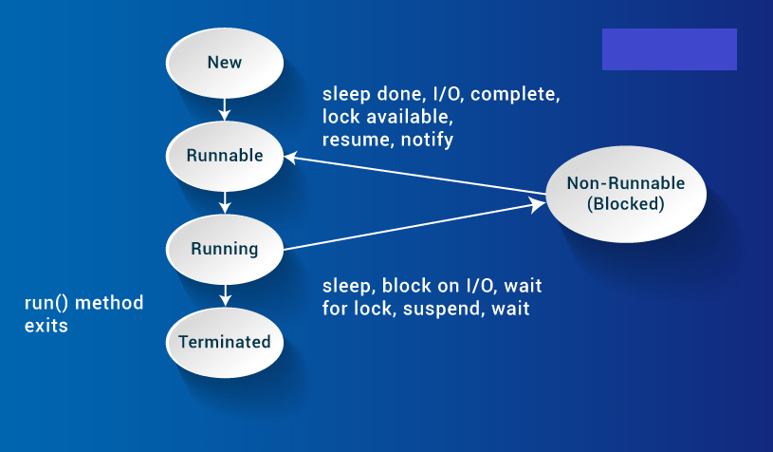
The Java Thread Model :

Slide 8
Multithreading in Java : Thread Class and Runnable Interface
Java’s multithreading system is built upon the Thread class, its methods, and its companion interface, Runnable.
To create a new thread, your program will either extend Thread or implement the Runnable interface.

Slide 9
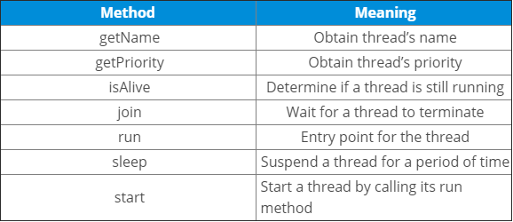
Multithreading in Java : Thread Class and Runnable Interface
The Thread class defines several methods that help manage threads.The table below displays the same:

Slide 10
Main Java Thread :
Now let us see how to use Thread and Runnable interface to create and manage threads, beginning with the main java thread, that all Java programs have. So, let us discuss the main thread.

Slide 11
Main Java Thread :
Why is Main Thread so important?
Because this thread effects the other ‘child’ threads
Because it performs various shutdown actions
It is created automatically when your program is started.

Slide 12
How to Create a Java Thread?
Java lets you create thread in following two ways:-
By implementing the Runnable interface.
By extending the Thread

Slide 13

Runnable Interface :
The easiest way to create a thread is to create a class that implements the Runnable interface.
To implement Runnable interface, a class need only implement a single method called
run( ), which is declared like this:

Slide 14
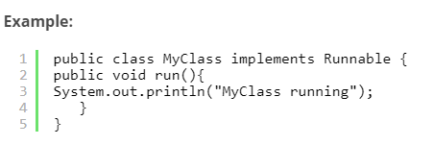
Runnable Interface :
Inside run( ), we will define the code that constitutes the new thread.

Slide 15

Runnable Interface :
To execute the run() method by a thread, pass an instance of MyClass to a Thread in its constructor(A constructor in Java is a block of code similar to a method that’s called when an instance of an object is created). Here is how that is done:

Slide 16
Runnable Interface :
When the thread is started it will call the run() method of the MyClass instance instead of executing its own run() method. The above example would print out the text “MyClass running“.

Slide 17
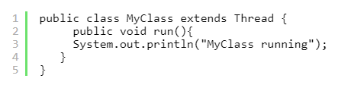
Extending Java Thread :
The second way to create a thread is to create a new class that extends Thread, then override the run() method and then to create an instance of that class. The run() method is what is executed by the thread after you call start(). Here is an example of creating a Java Thread subclass:

Slide 18

Extending Java Thread :
To create and start the above thread you can do like this:
When the run() method executes it will print out the text “MyClass running“.

Slide 19
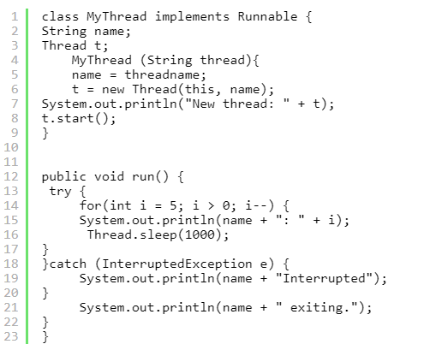
Creating Multiple Threads :

Slide 20
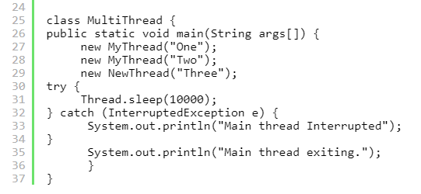
Creating Multiple Threads :

Slide 21
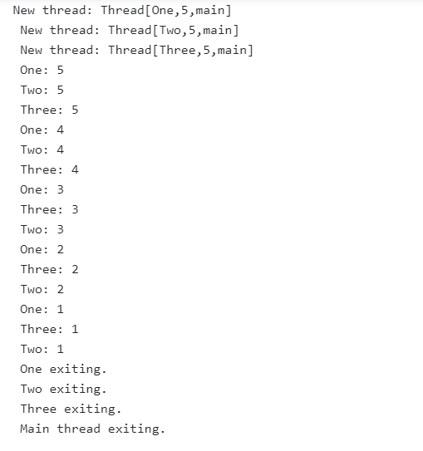
Creating Multiple Threads (Output):

Slide 22
References :
https://www.edureka.co/blog/java-thread/.

Slide 23
Thanks

